Slide 1
ROOM OCCUPANCY
Link- https://www.kaggle.com/tombutton/roomoccupancy
Data- occupancy

Slide 2
CHALLENGES IN THE PROJECT
Dealing with date column was difficult.
Dilemma whether to consider various columns as categorical or continuous.

Slide 3
MAJOR FINDINGS THROUGH EDA
Important factors which can be considered to decide room occupancy.

Slide 4
MY LEARNING
Decision making whether to consider a column as categorical or continuous.

Slide 5
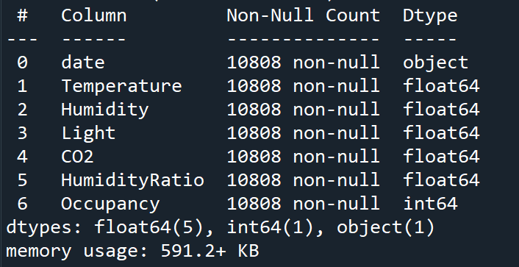
BINARY CLASSIFICATION
Shape- (10808, 7)

Slide 6
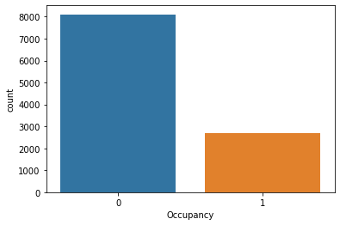
TARGET VARIABLE- ‘Occupancy’
Categorical variable
No null values
0: Not occupied,
1: Occupied

Slide 7
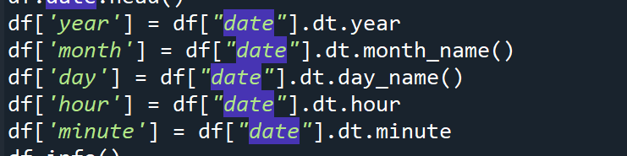
1st Variable- Date
Date variable has been split into :-
Year, month, day, hour, minute

Slide 8
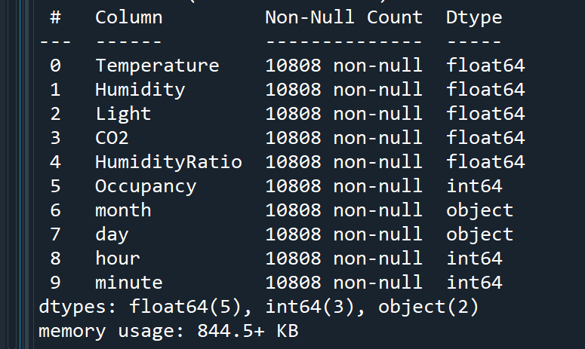
New columns:-

Slide 9
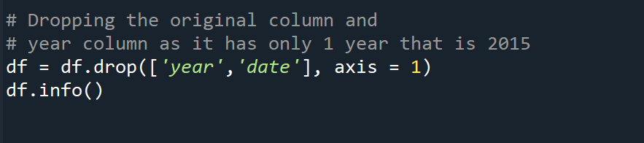
Dropping date, which is the original column and also year as it has same value i.e., 2015

Slide 10
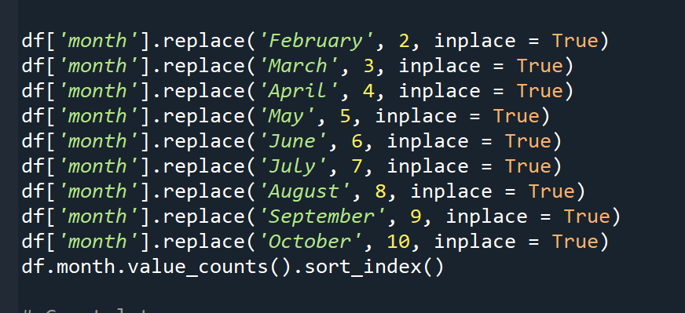
1(b) Variable- Month
Continuous variable- No null values
No outliers

Slide 11
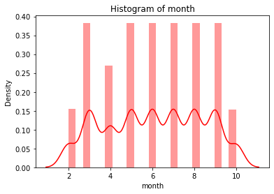
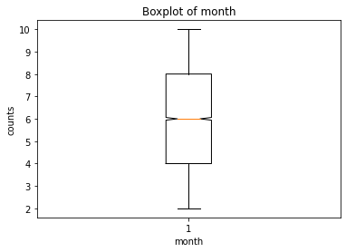

Slide 12
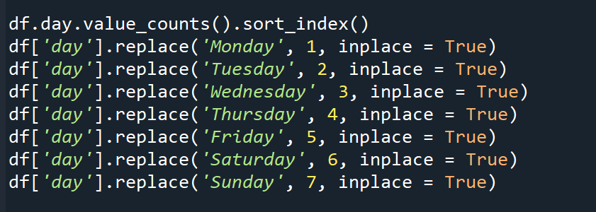
1(c) Variable- Day
Continuous variable- No null values
No outliers

Slide 13
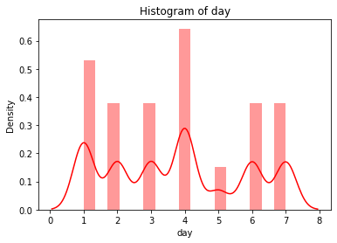
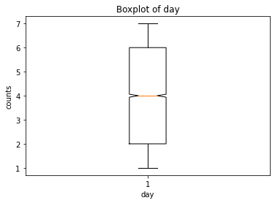

Slide 14
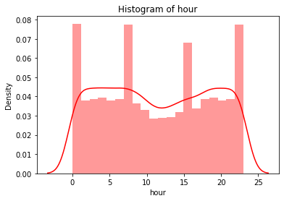
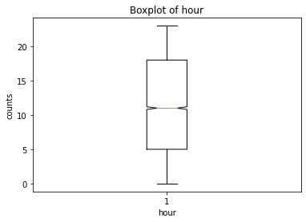
1(d) Variable- Hour
Continuous variable- No null values
No outliers

Slide 15
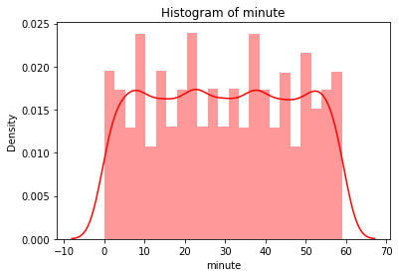

1(e) Variable- Minute
Continuous variable- No null values
No outliers

Slide 16
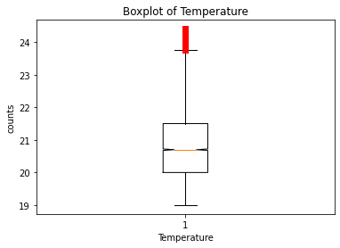
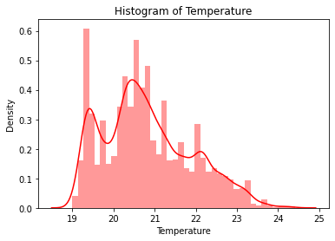
2nd Variable- Temperature
Continuous variable- No null values
There are outliers

Slide 17
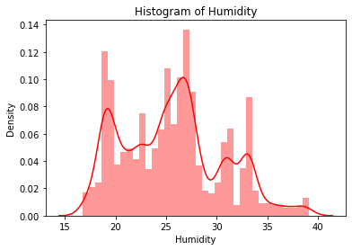
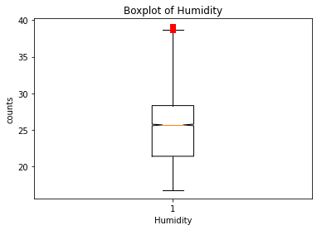
3rd Variable- Humidity
Continuous variable- No null values
There are outliers

Slide 18
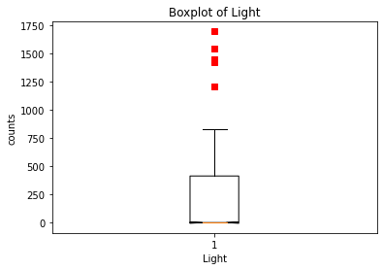
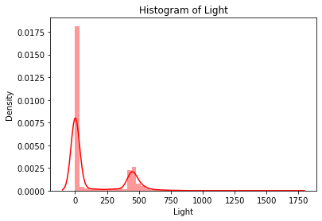
4th Variable- Light
Continuous variable- No null values
There are outliers

Slide 19
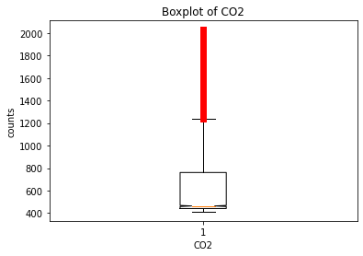
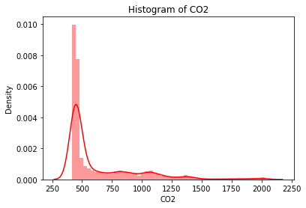
5th Variable- CO2
Continuous variable- No null values
There are outliers

Slide 20
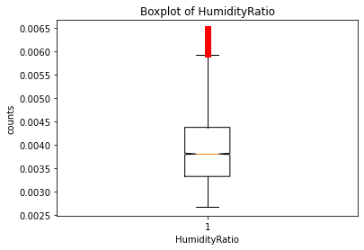
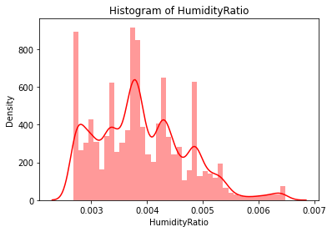
6th Variable- HumidityRatio
Continuous variable- No null values
There are outliers

Slide 21
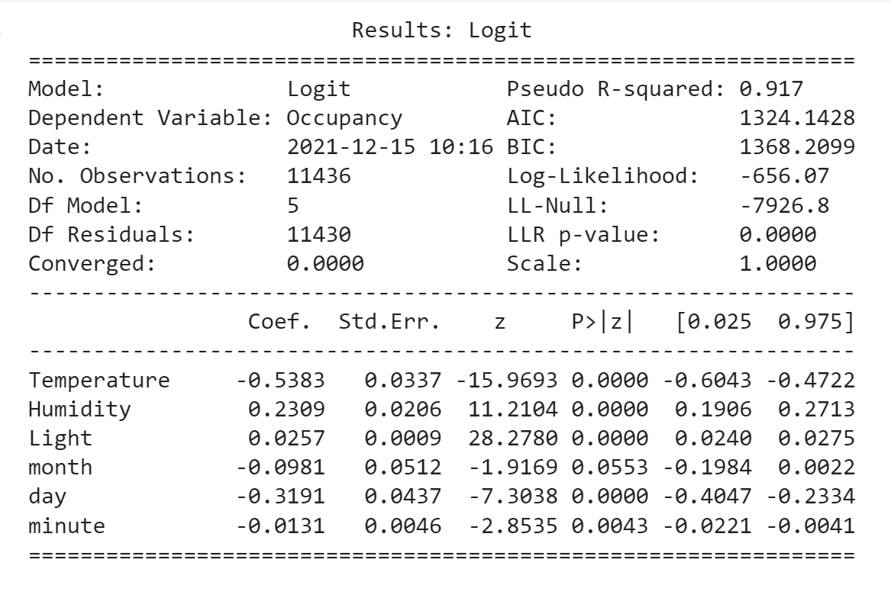
LOGISTIC MODEL BY STATISTIC APPROACH
Recursive Feature Elimination= 6

Slide 22
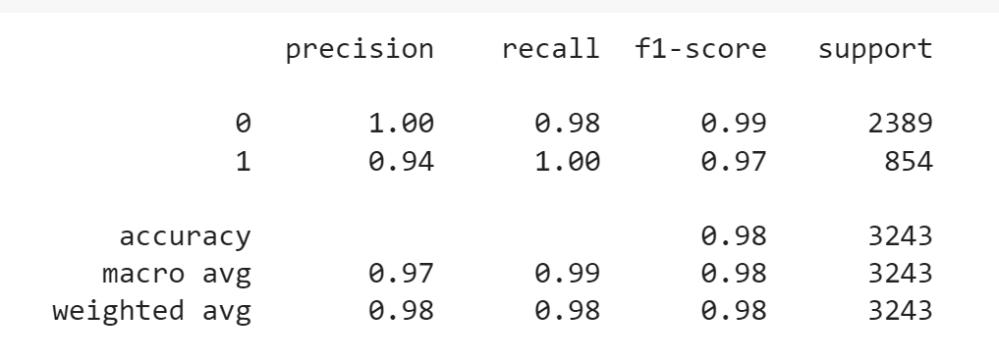
LOGISTIC MODEL BY SK LEARN APPROACH
print("Accuracy of logistic regression classifier on test data:{}".format(log_score))

Slide 23
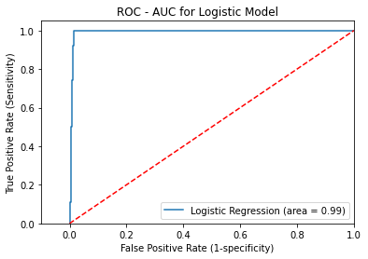

Slide 24
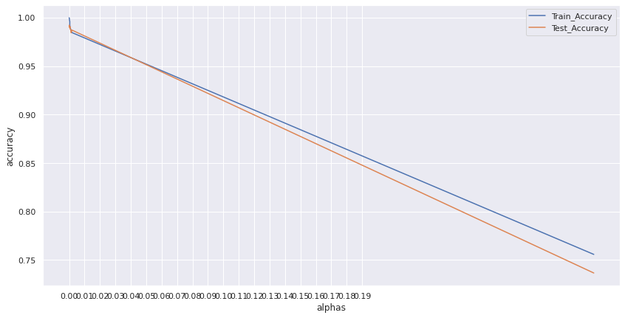
DECISION TREE MODEL
Ccp alpha-

Slide 25
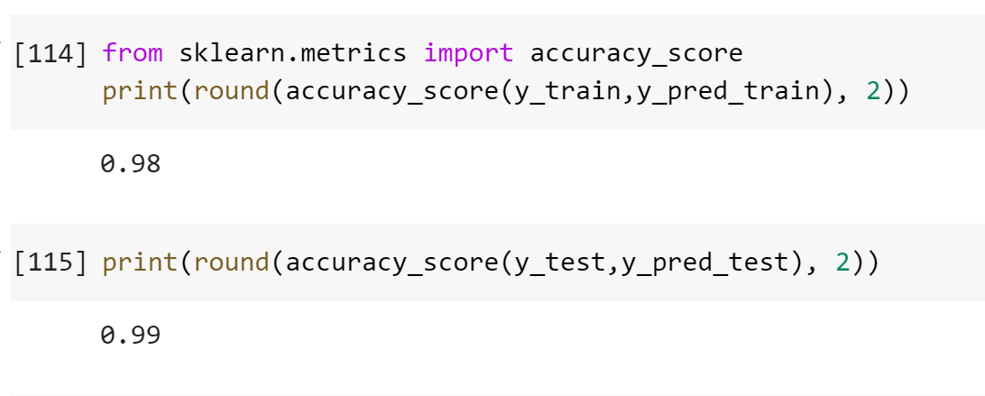

Slide 26
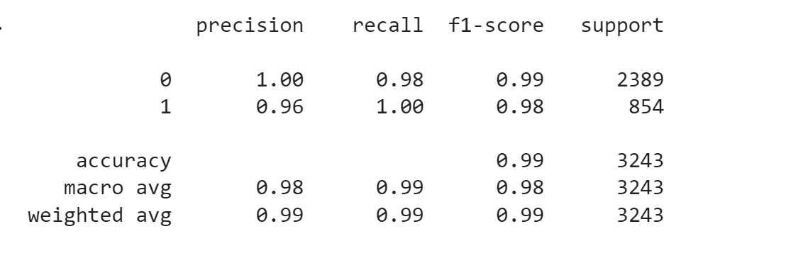

Slide 27
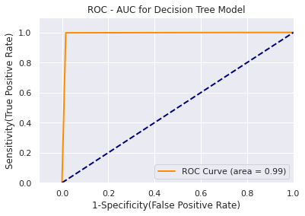

Slide 28
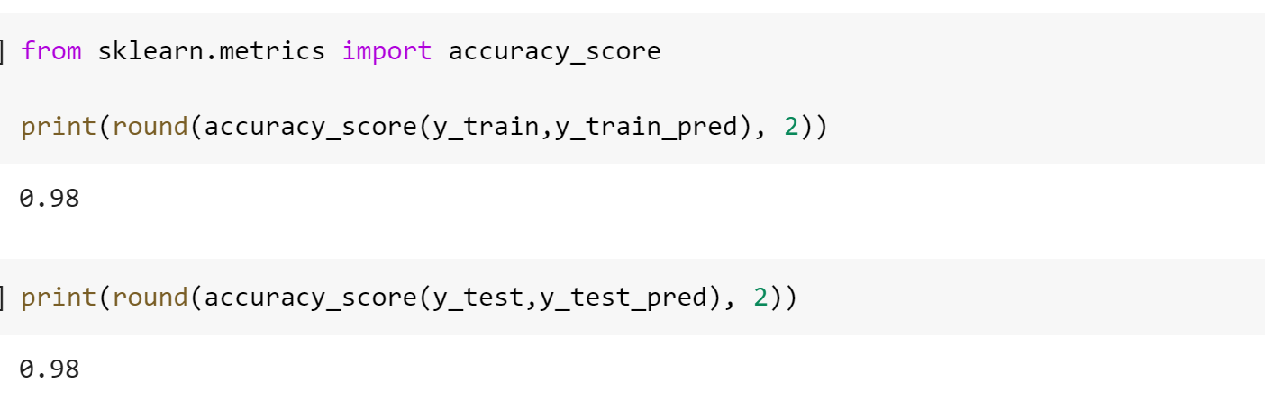
RANDOM FOREST MODEL

Slide 29
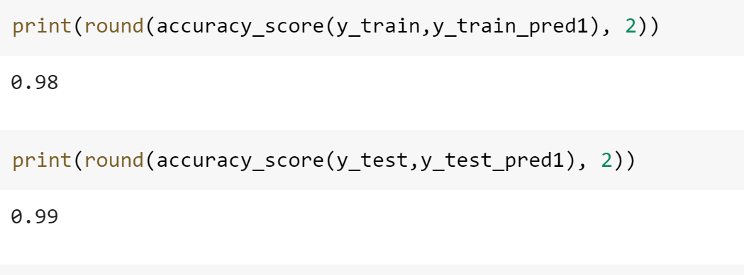
EXTRACT FEATURE ELIMINATION- 2

Slide 30
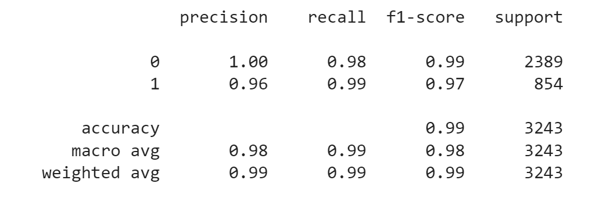

Slide 31
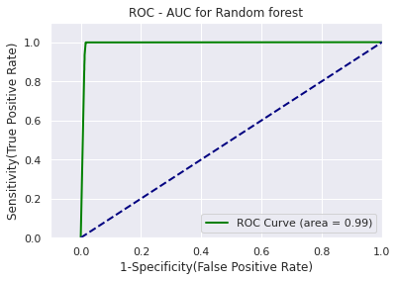

Slide 32
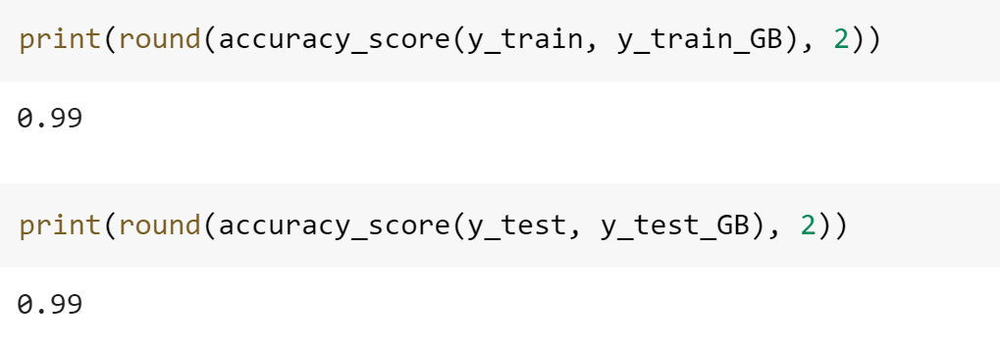
GRADIENT BOOSTING MODEL

Slide 33
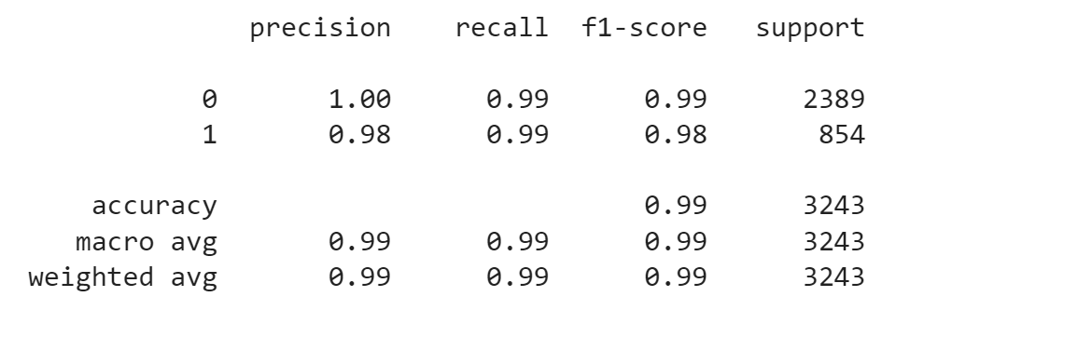

Slide 34
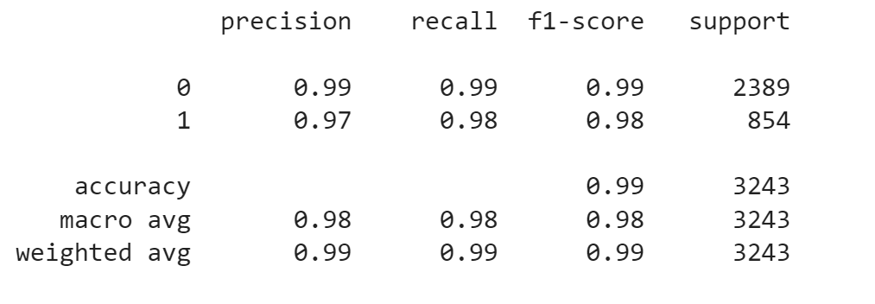
KNOWING YOUR NEAREST NEIGHBORS

Slide 35
We can see all the models have almost same accuracy. So all the models can be considered as good.

Slide 36
THANK YOU

